Slide 1
Limitations of technology in calculations
Comparing and ordering fractions and decimals (positive and negative)

Slide 2
how to use Oak lessons

Slide 3
I can enter fractions as divisions on a calculator (and other technology) and understand the limitations of the decimal representation that results.

Slide 4
A terminating decimal is one that has a finite number of digits after the decimal point.
Example
Example
Non example
Non example

Slide 5

A recurring decimal is one that has an infinite number of digits after the decimal point.
The recurring digits after the decimal point are represented using dots. A dot is placed above the first digit that recurs and the last digit that recurs.
Example
Example
Example

Slide 6

Limitations of technology in calculations
Correct inputs
Calculator display and limitations

Slide 7
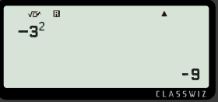
Correct inputs
Scientific calculators are fantastic tools, but it is important to remember that calculators work out what is inputted.
The incorrect input will give the wrong answer and it is not the fault of the calculator.
For example
Laura wants to work out -3 squared.
She inputs
Where is her error?

Slide 8
Correct inputs
Scientific calculators are fantastic tools, but it is important to remember that calculators work out what is inputted.
The incorrect input will give the wrong answer and it is not the fault of the calculator.
For example
Laura wants to work out -3 squared.
She inputs
She should use brackets when inputting negative numbers.

Slide 9
Correct inputs
Why did the calculator work out the answer to be -9?
It is not the fault of the calculator.
Scientific calculators have the priority of operations installed, so the calculator was correctly applying the exponent first then making the final answer negative.

Slide 10
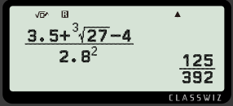
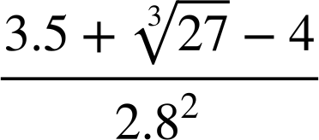
Correct inputs
Some scientific calculators have displays where the calculation you want to work out will look the same on the calculator display.
For example
Calculation
Calculator

Slide 11

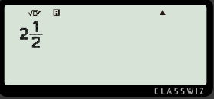
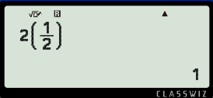

Correct inputs
However, if the input is incorrect, even though it may look the same on the calculator display, different buttons or functions have been used.
For example,
Write
as a decimal.
Inputting this

Slide 12
Correct inputs
Clearly it is incorrect, but can you explain how the calculator worked out the answer to be 1?
For example,
Write
as a decimal.
Inputting this

Slide 13
Correct inputs
Clearly it is incorrect, but can you explain how the calculator worked out the answer to be 1?
The input has told the calculator to multiply 2 by ½ which has then calculated the answer to be 1.
Inputting this

Slide 14
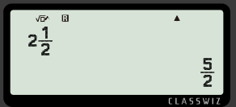



Correct inputs
Which button should have been accessed to
convert
as a decimal?
Then,
to
convert
to
a
decimal
press

Slide 15
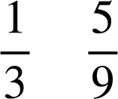
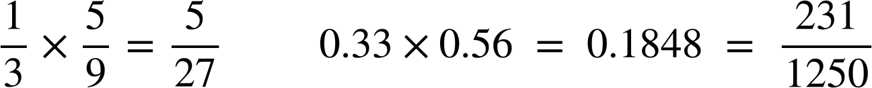
Correct inputs
Aisha and Alex are working out the following calculation.
Work out the area of the rectangle.
m
m
Aisha’s working out:
Who is more accurate and why?
Alex’s working out:
m²
m²

Slide 16
Correct inputs
Aisha and Alex are working out the following calculation.
Work out the area of the rectangle.
m
m
Aisha because the recurring decimal is exactly represented as a fraction and not rounded.
Aisha’s working out:
Alex’s working out:
m²
m²

Slide 17
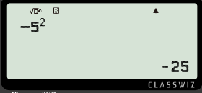
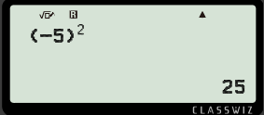
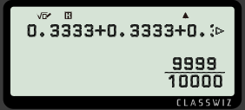
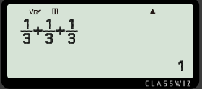
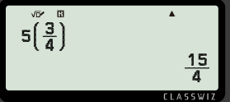
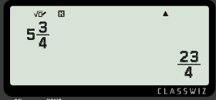
Correct inputs
Circle the correct and/or accurate calculation on the calculator display for the following:
The square of negative 5
a)
b)
0.3333… + 0.3333…. + 0.3333…
c)
5 multiplied by ¾

Slide 18

Correct inputs
Andeep, Jun and Jacob want to buy a cake and divide the amount equally between them.
£13
Each student pays the cake shop manager £4.33 each.
Explain why the cake shop manager is not going to give them the cake.

Slide 19
Correct inputs
Circle the correct and/or accurate calculation on the calculator display for the following:
The square of negative 5
a)
b)
0.3333… + 0.3333…. + 0.3333…
c)
5 multiplied by ¾

Slide 20
Correct inputs
Andeep, Jun and Jacob want to buy a cake and divide the amount equally between them.
£13
Each student pays the cake shop manager £4.33 each.
Explain why the cake shop manager is not going to give them the cake.
3 lots of £4.33 does not sum to £13.
They have not paid the full price. They are 1 penny short.

Slide 21
Limitations of technology in calculations
Correct inputs
Calculator display and limitations

Slide 22

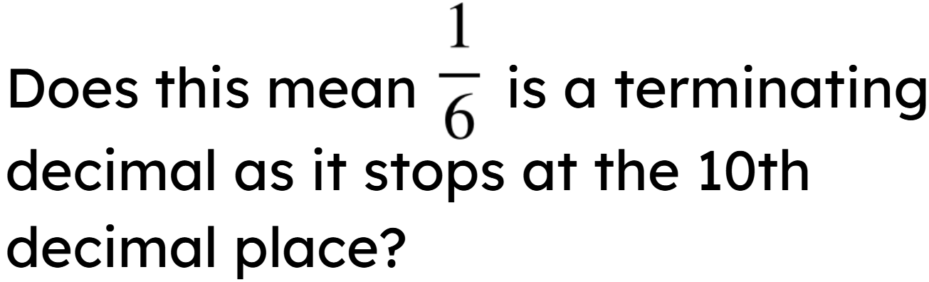
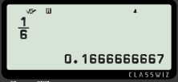
Calculator display and limitations
Calculators are fantastic, but it is important to remember they only have a limited number of digits.
For example,
Write all the digits displayed on your calculator screen when
converting
into a decimal.

Slide 23
Calculator display and limitations
Calculators are fantastic, but it is important to remember they only have a limited number of digits.
For example,
Write all the digits displayed on your calculator screen when
converting
into a decimal.
Because the calculator is limited to 12 digit display, the final digit is rounded.
It is a recurring decimal.

Slide 24
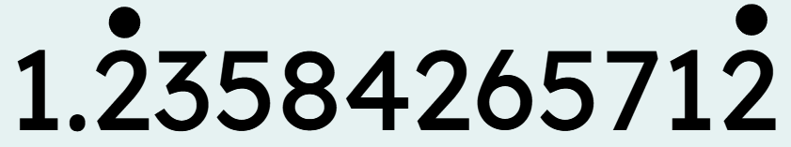

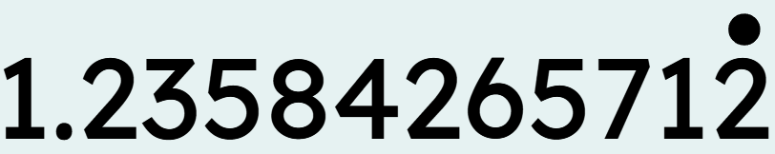
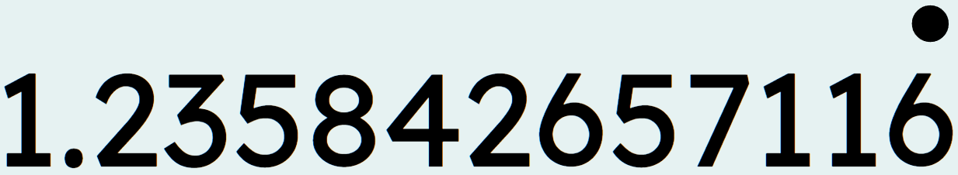
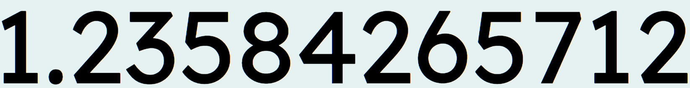
Calculator display and limitations
The calculator displays the decimal 1.23584265712
Which of the following could this decimal be?
It could be that the whole sequence of digits recur.
It could be that the last digit 2 recurs.
They are all possible!
It could be that the last digit 2 is rounded because the 6 after it recurs.
It could be that this is a terminating decimal.

Slide 25
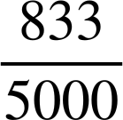
Calculator display and limitations
There is no button on the Classwiz to show a recurring decimal.
We must use the fractional equivalent, if known, or type in the recurring decimal a minimum of 18 decimal places for a number less than 1.
For example,
Input | Output
0.166666666666666666

Slide 26
Calculator display and limitations
We have also looked at how scientific calculators can convert terminating decimals into fractions easily.
However, there is a limit at which the scientific calculator will convert the decimal into a fraction.
Let’s see if you can investigate and find out when a scientific calculator stops converting a terminating decimal into a fraction.

Slide 27
Calculator display and limitations
Investigation - numbers less than 1
Decimal places | Example input | Does the calculator convert it to a fraction?
1 | 0.1
2 | 0.12
3 | 0.123
4 | 0.1234
5 | 0.12345
6 | 0.123456

Slide 28

Calculator display and limitations
Investigation - numbers less than 1
Decimal places | Example input | Does the calculator convert it to a fraction?
7 | 0.1234567
For a number less than 1, the scientific calculator stops converting the terminating decimal into a fraction when there are 7 or more decimal places.
But what about numbers greater than 1?

Slide 29
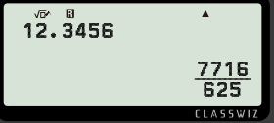
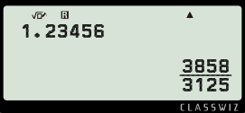
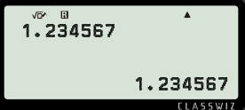
Calculator display and limitations
Investigation - numbers greater than 1
Investigate how many digits the decimal must have in order for the scientific calculator to convert the number into a fraction.
To convert terminating decimals to fractions, they must have fewer than 7 digits.
Example
Example
Non example

Slide 30
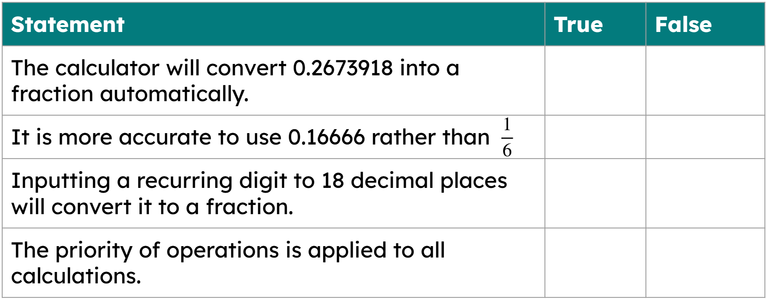
Calculator display and limitations
Identify if the statement is true or false when using the scientific calculator Casio Classwiz fx 991.

Slide 31
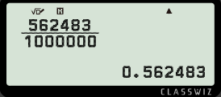
Calculator display and limitations
2) Andeep has discovered a way to find the fractional form of a decimal when the calculator does not do it automatically.
What is the fractional form of 0.346774?
What is the simplified fractional form of 0.346774?

Slide 32

Calculator display and limitations
3) A calculator displays this number
Give three examples, in decimal form, of what this number could be if it were a recurring decimal.
Give an example of a fraction it could be if it were a terminating decimal.

Slide 33
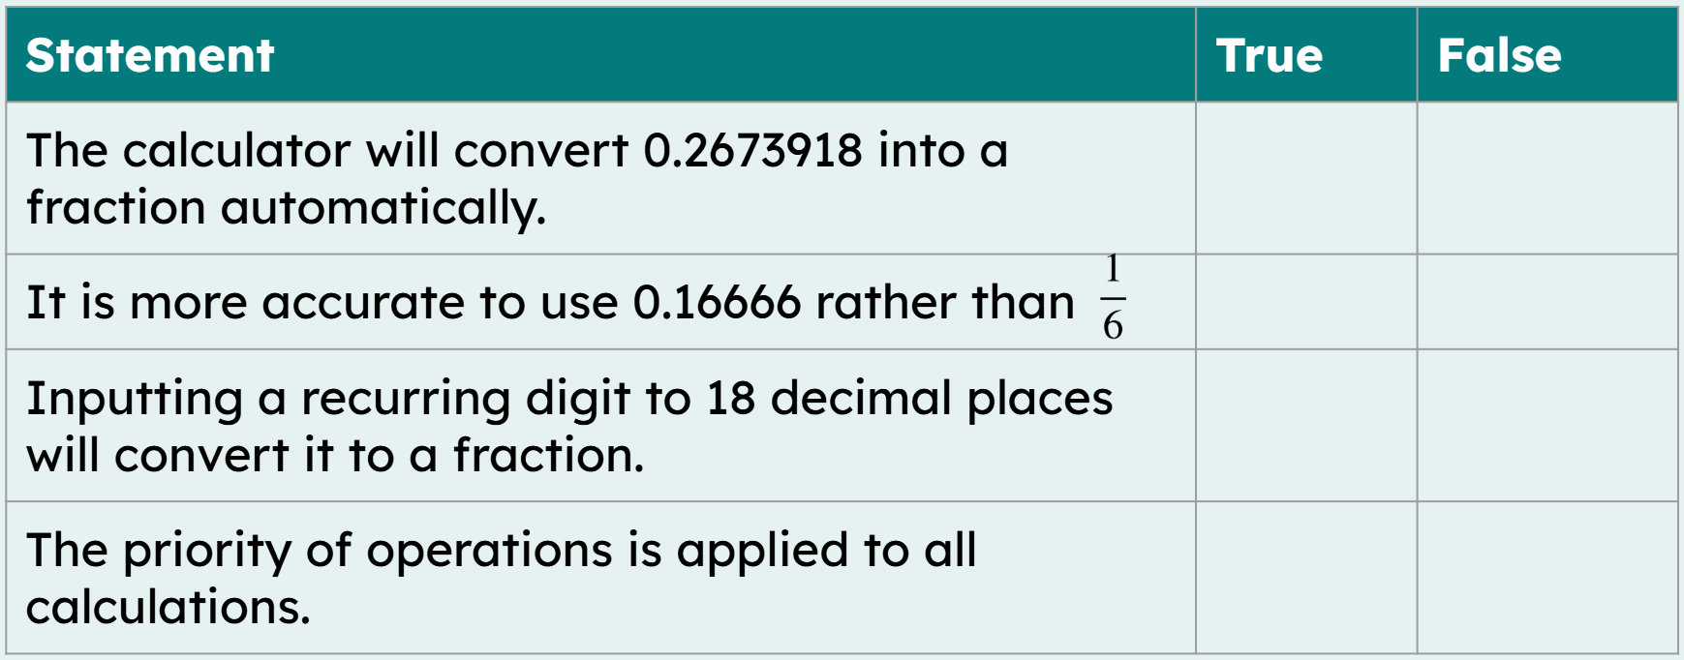
Calculator display and limitations
Identify if the statement is true or false when using the scientific calculator Casio Classwiz fx 991.

Slide 34
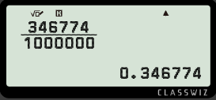
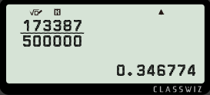
Calculator display and limitations
2) Andeep has discovered a way to find the fractional form of a decimal when the calculator does not do it automatically.
What is the fractional form of 0.346774?
What is the simplified fractional form of 0.346774?

Slide 35
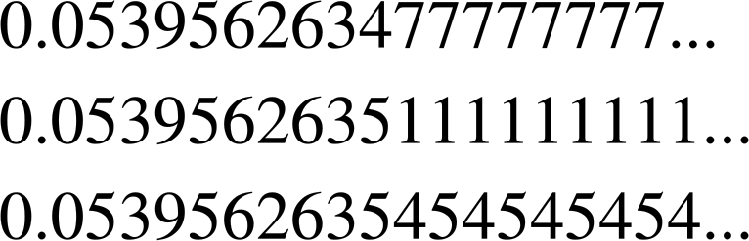
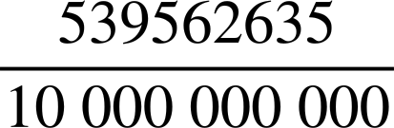
Calculator display and limitations
3) A calculator displays this number
Give three examples, in decimal form, of what this number could be if it were a recurring decimal.
Give an example of a fraction it could be if it were a terminating decimal.
Some examples of a
non-terminating decimal
b) It could be this terminating decimal

Slide 36
Limitations of technology in calculations
Using fractions to represent terminating or non-terminating decimals is generally better for accuracy.
Scientific calculators are fantastic tools, but only output what has been inputted so you must check your calculations carefully.
Scientific calculators do have their limitations, including:
Inputting recurring decimals (input more than 18 decimal places).
When converting terminating decimals to fractions, they must have less than 7 significant figures.
They can only display a certain number of digits on the screen then it will round, but you may not know it has been rounded.

Slide 37

© Oak National Academy 2023.
Produced in partnership with Mathematics in Education and Industry.
Licensed on the Open Government Licence v3.0, except where otherwise stated. See Oak terms and conditions.

